Slide 1
Online college election system
PRESENTED BY
Ms. Kiruthika Baskaran
TRAINER
Mr. Santhosh Mali

Slide 2
introduction
“Online Student Election System” is an online voting technique. In this students, who are from this corresponding college can give his/her vote online without going to any physical polling station.
He/she has to be registered first to vote manually.
After Registration, students can log in to the system and enroll their votes.

Slide 3
Software required
HTML
CSS
JavaScript
Java

Slide 4
features
User-friendly.
Secured login procedure.
Students easily know about the candidates.
Candidates can post their vision and able to modifies their profile anytime.

Slide 5
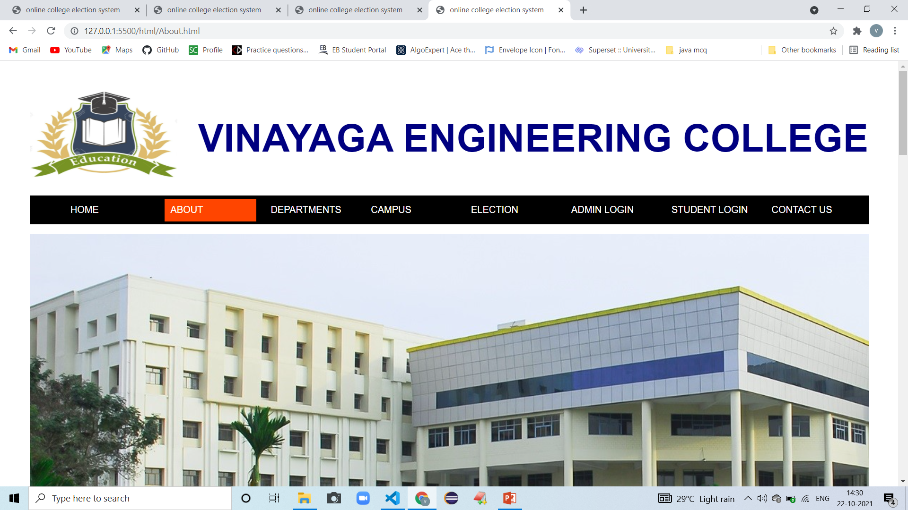
Header

Slide 6
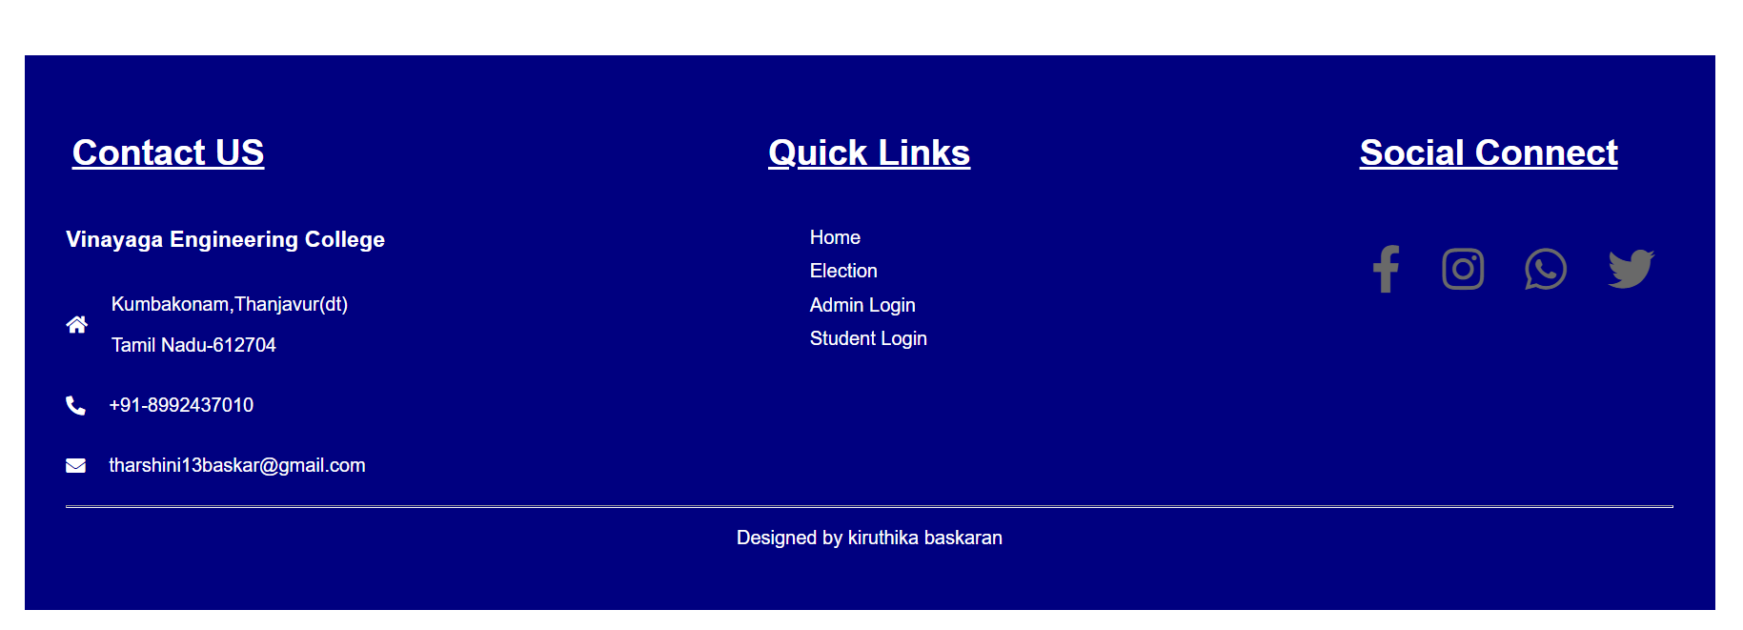
footer

Slide 7
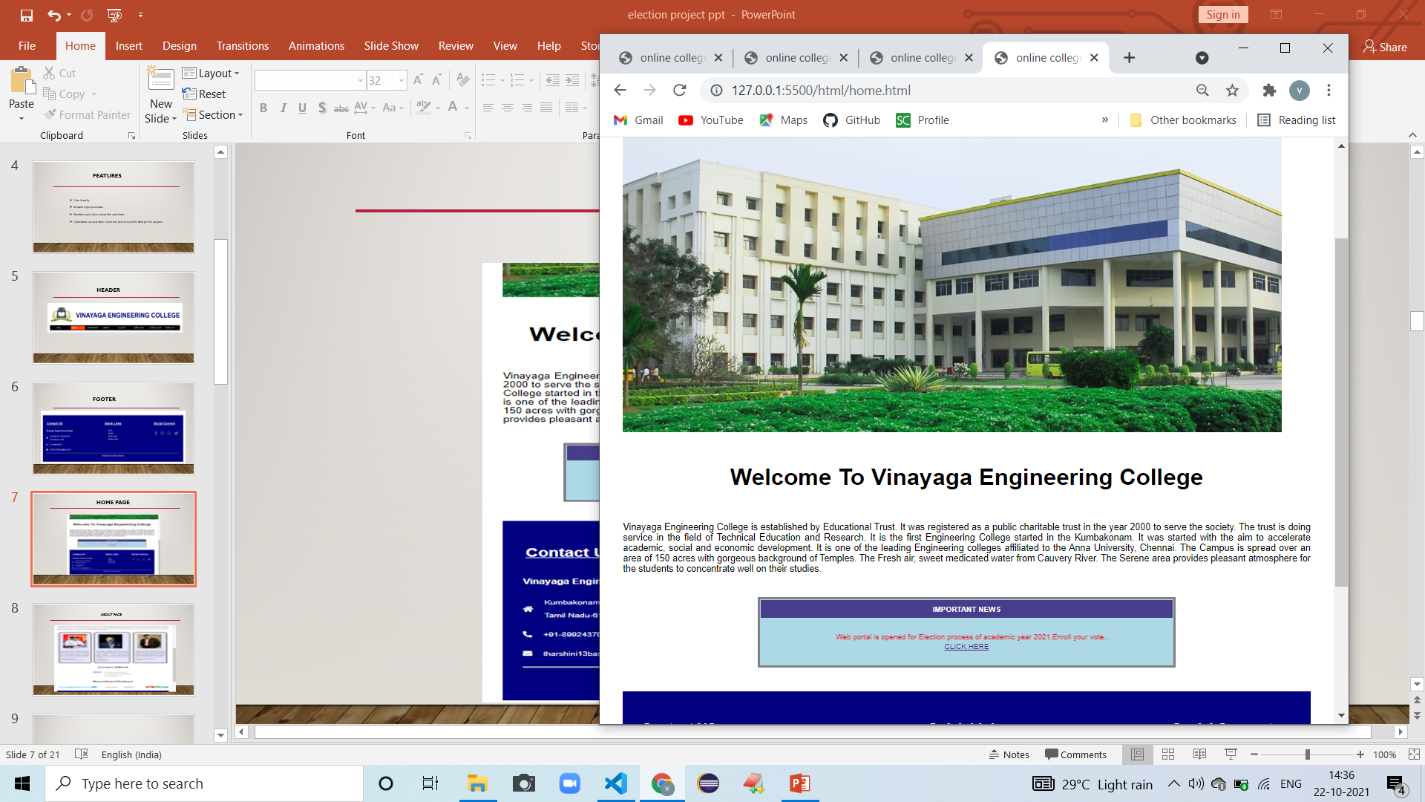
HOME PAGE

Slide 8
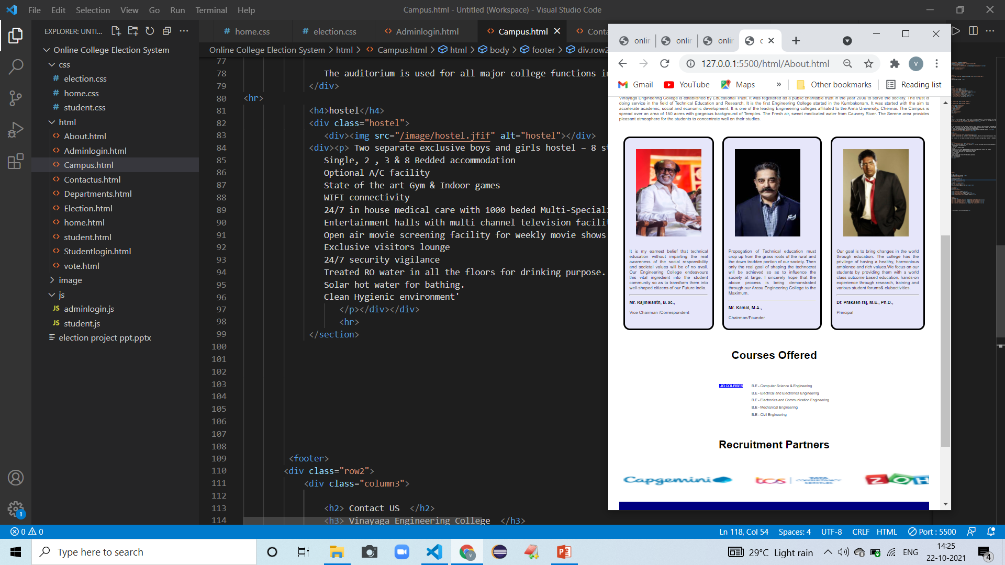
ABOUT PAGE

Slide 9
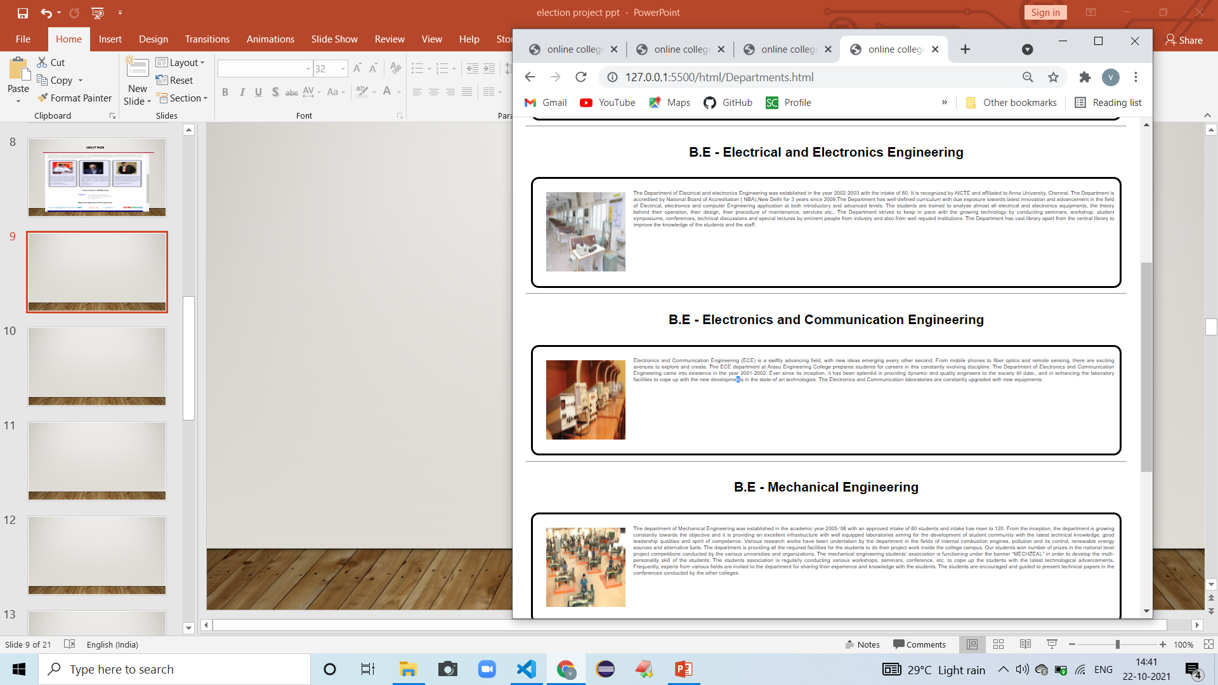
DEPARTMENT PAGE

Slide 10
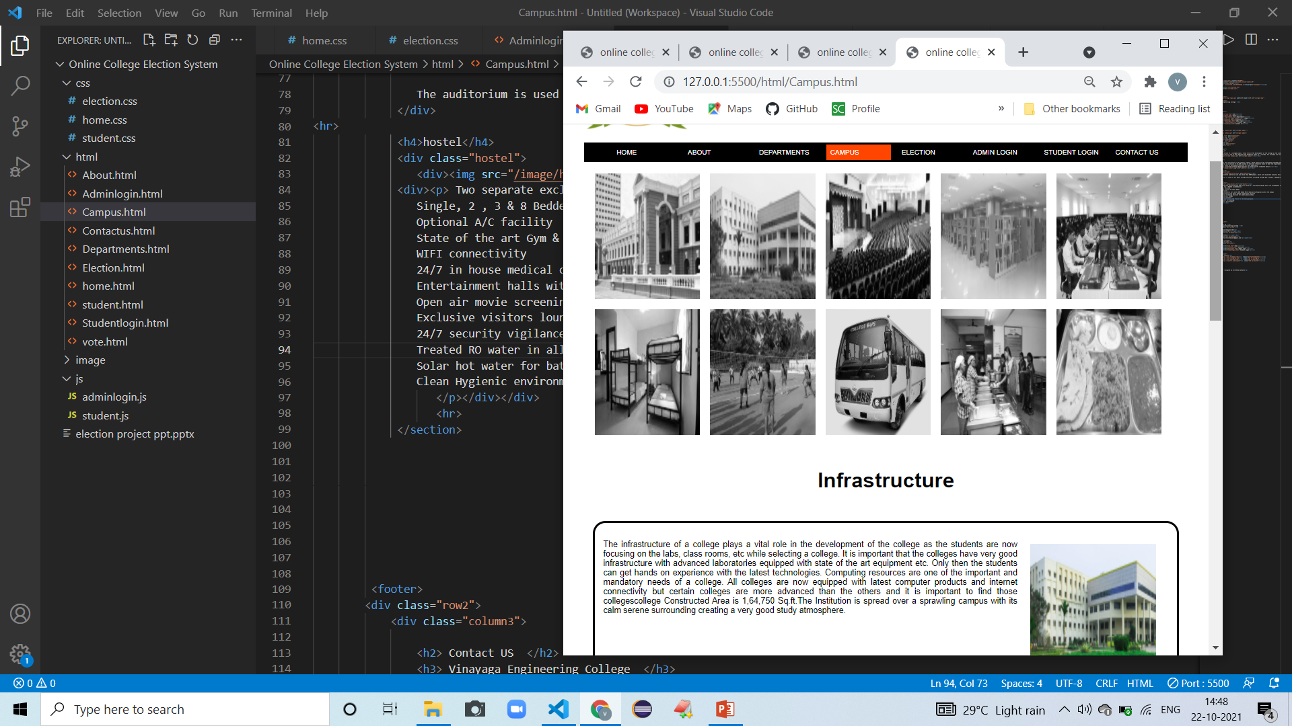
CAMPUS PAGE

Slide 11
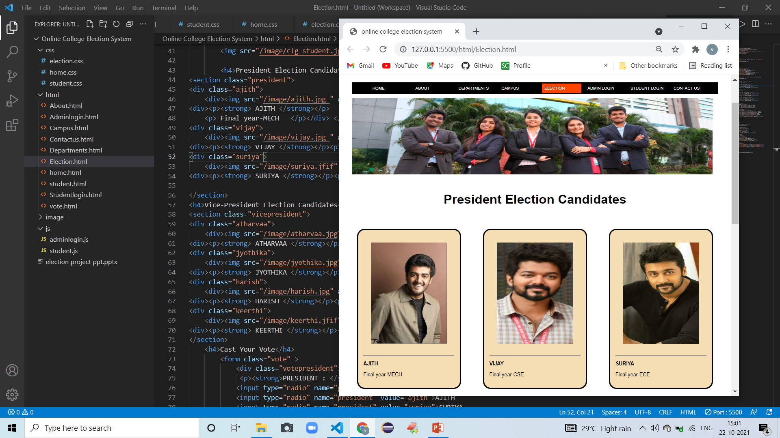
ELECTION PAGE

Slide 12
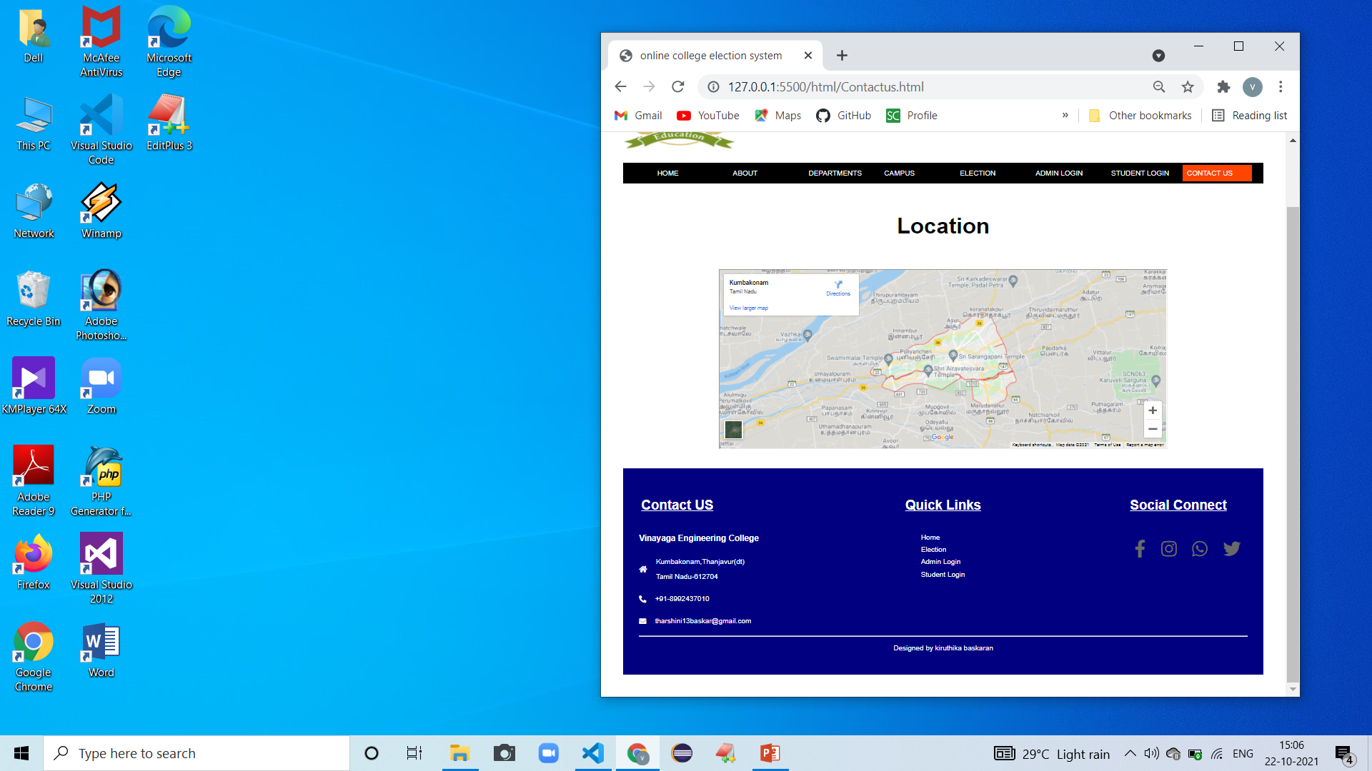
CONTACT PAGE

Slide 13
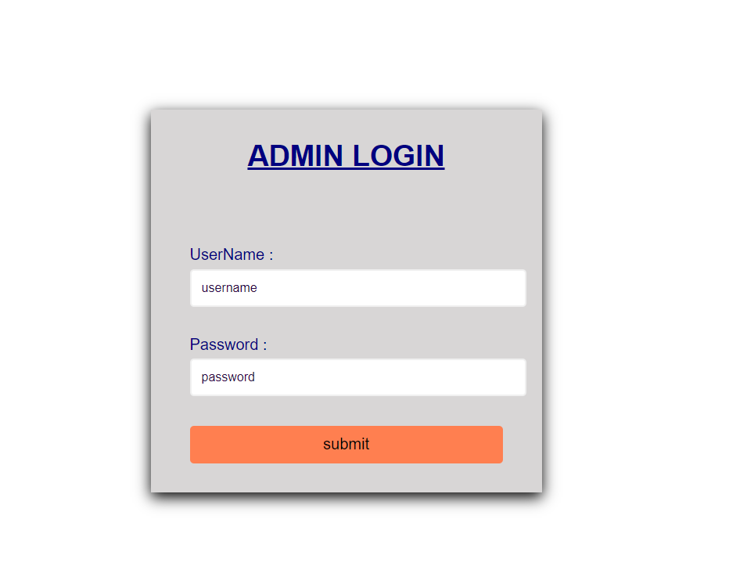
Admin login page

Slide 14
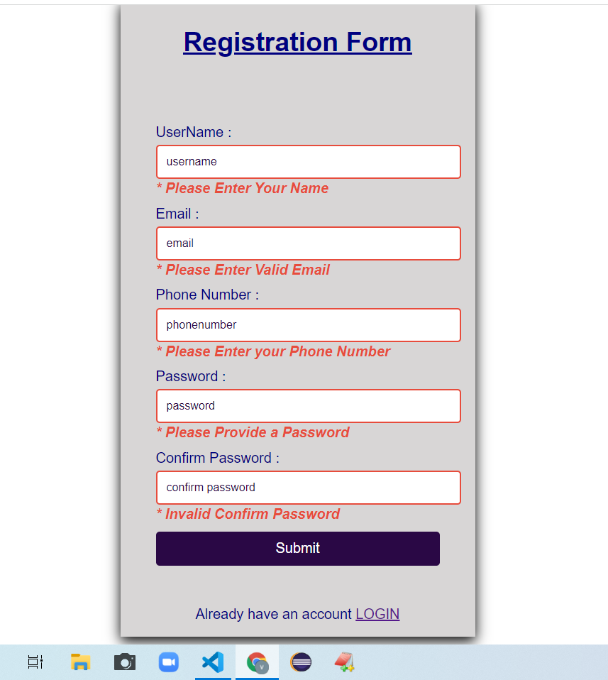
JAVASCRIPT
Student Registration Form validation.
Login form validation.

Slide 15
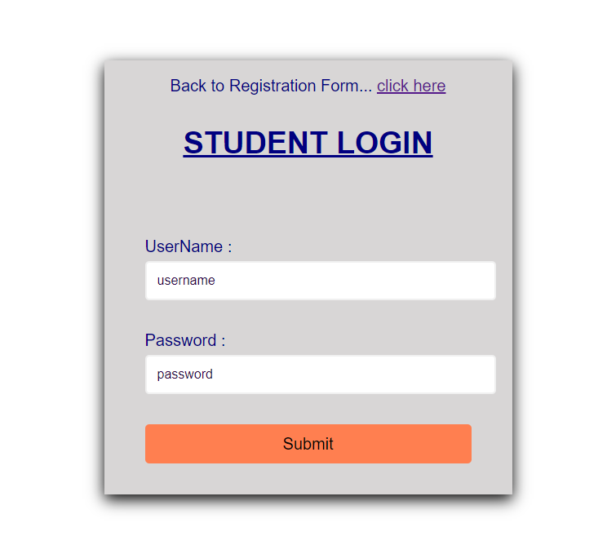
student login page

Slide 16
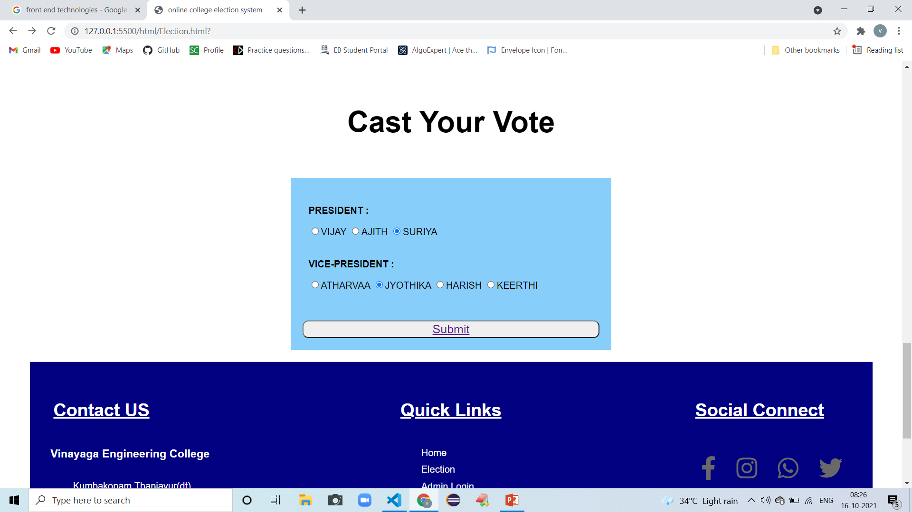
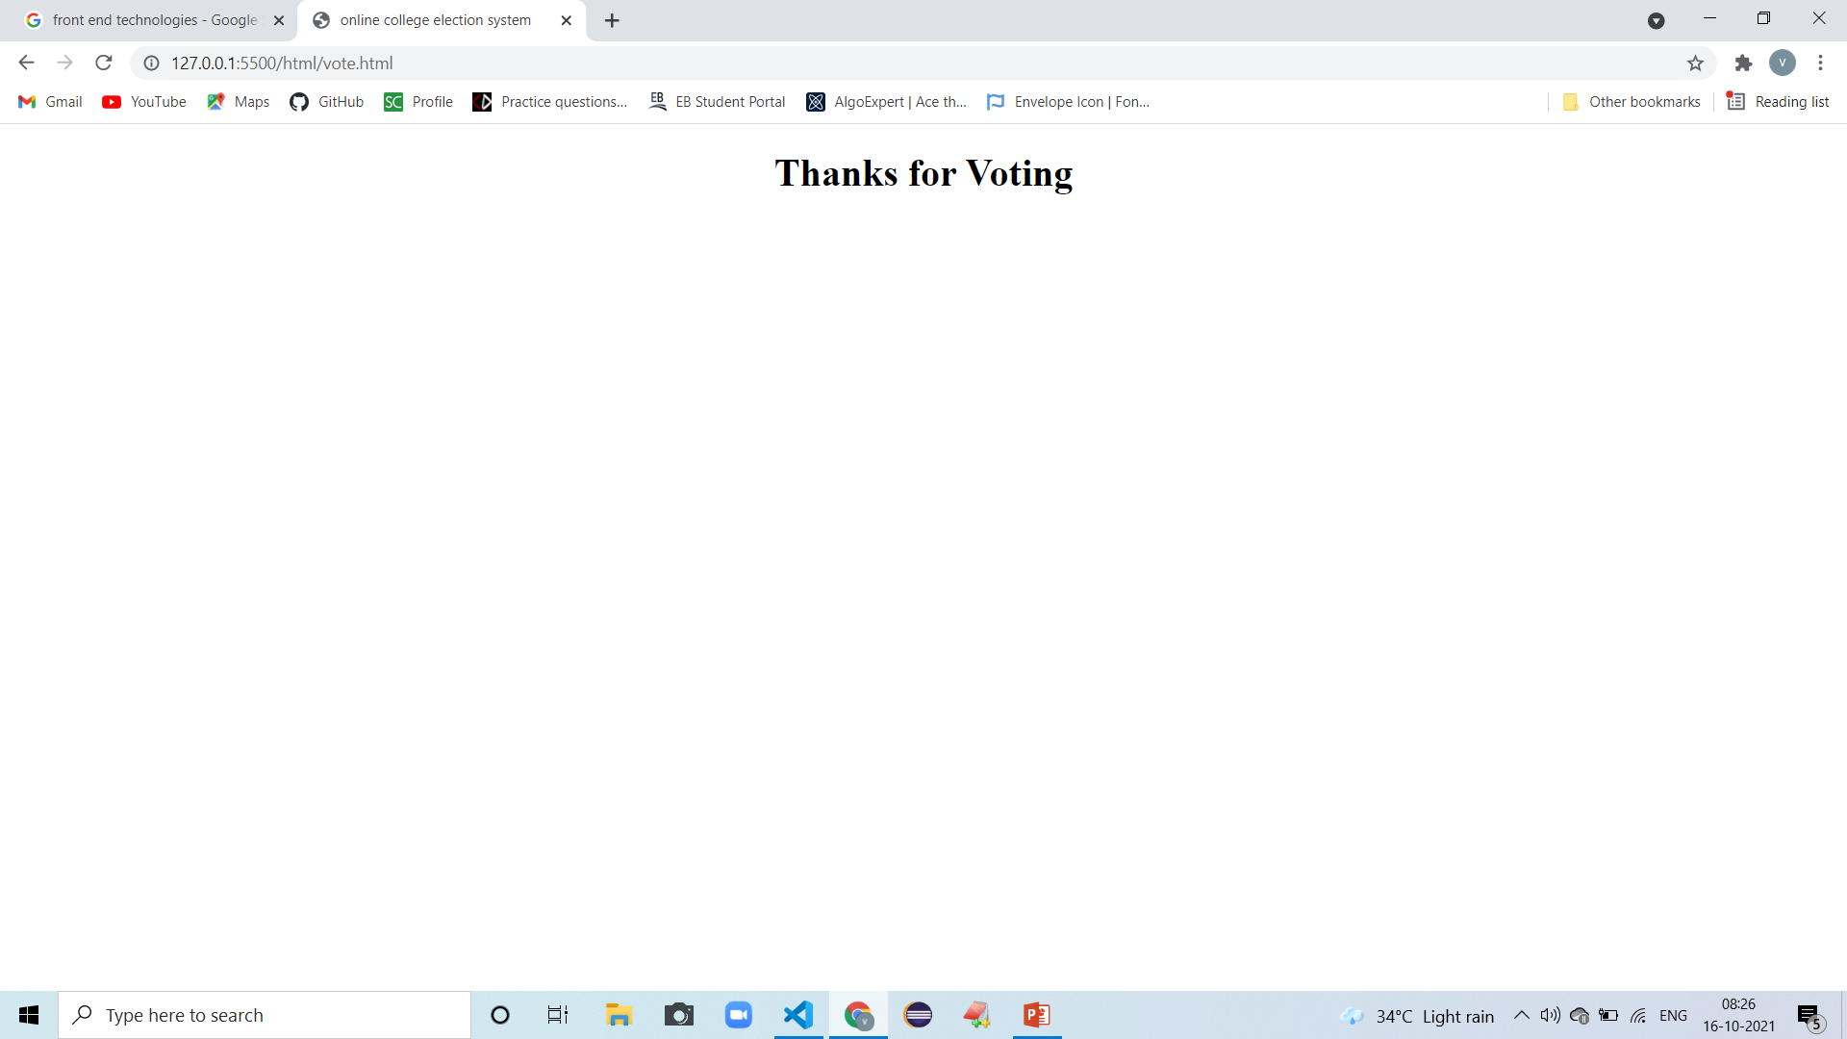
output

Slide 17
conclusion
Students who are registered in the Election Registration portal ,using that login id they enroll their votes anytime anywhere with the help of Internet.
separate tools for maintaining voter’s vote and counts total number of votes these are comes under database parts.

Slide 18
THANK YOU !!

